Slide 1


Advanced database development with Visual Studio Code
Jonathan Bregler, SAP
Thomas Grimmeisen, SAP
July 10, 2025

Slide 2
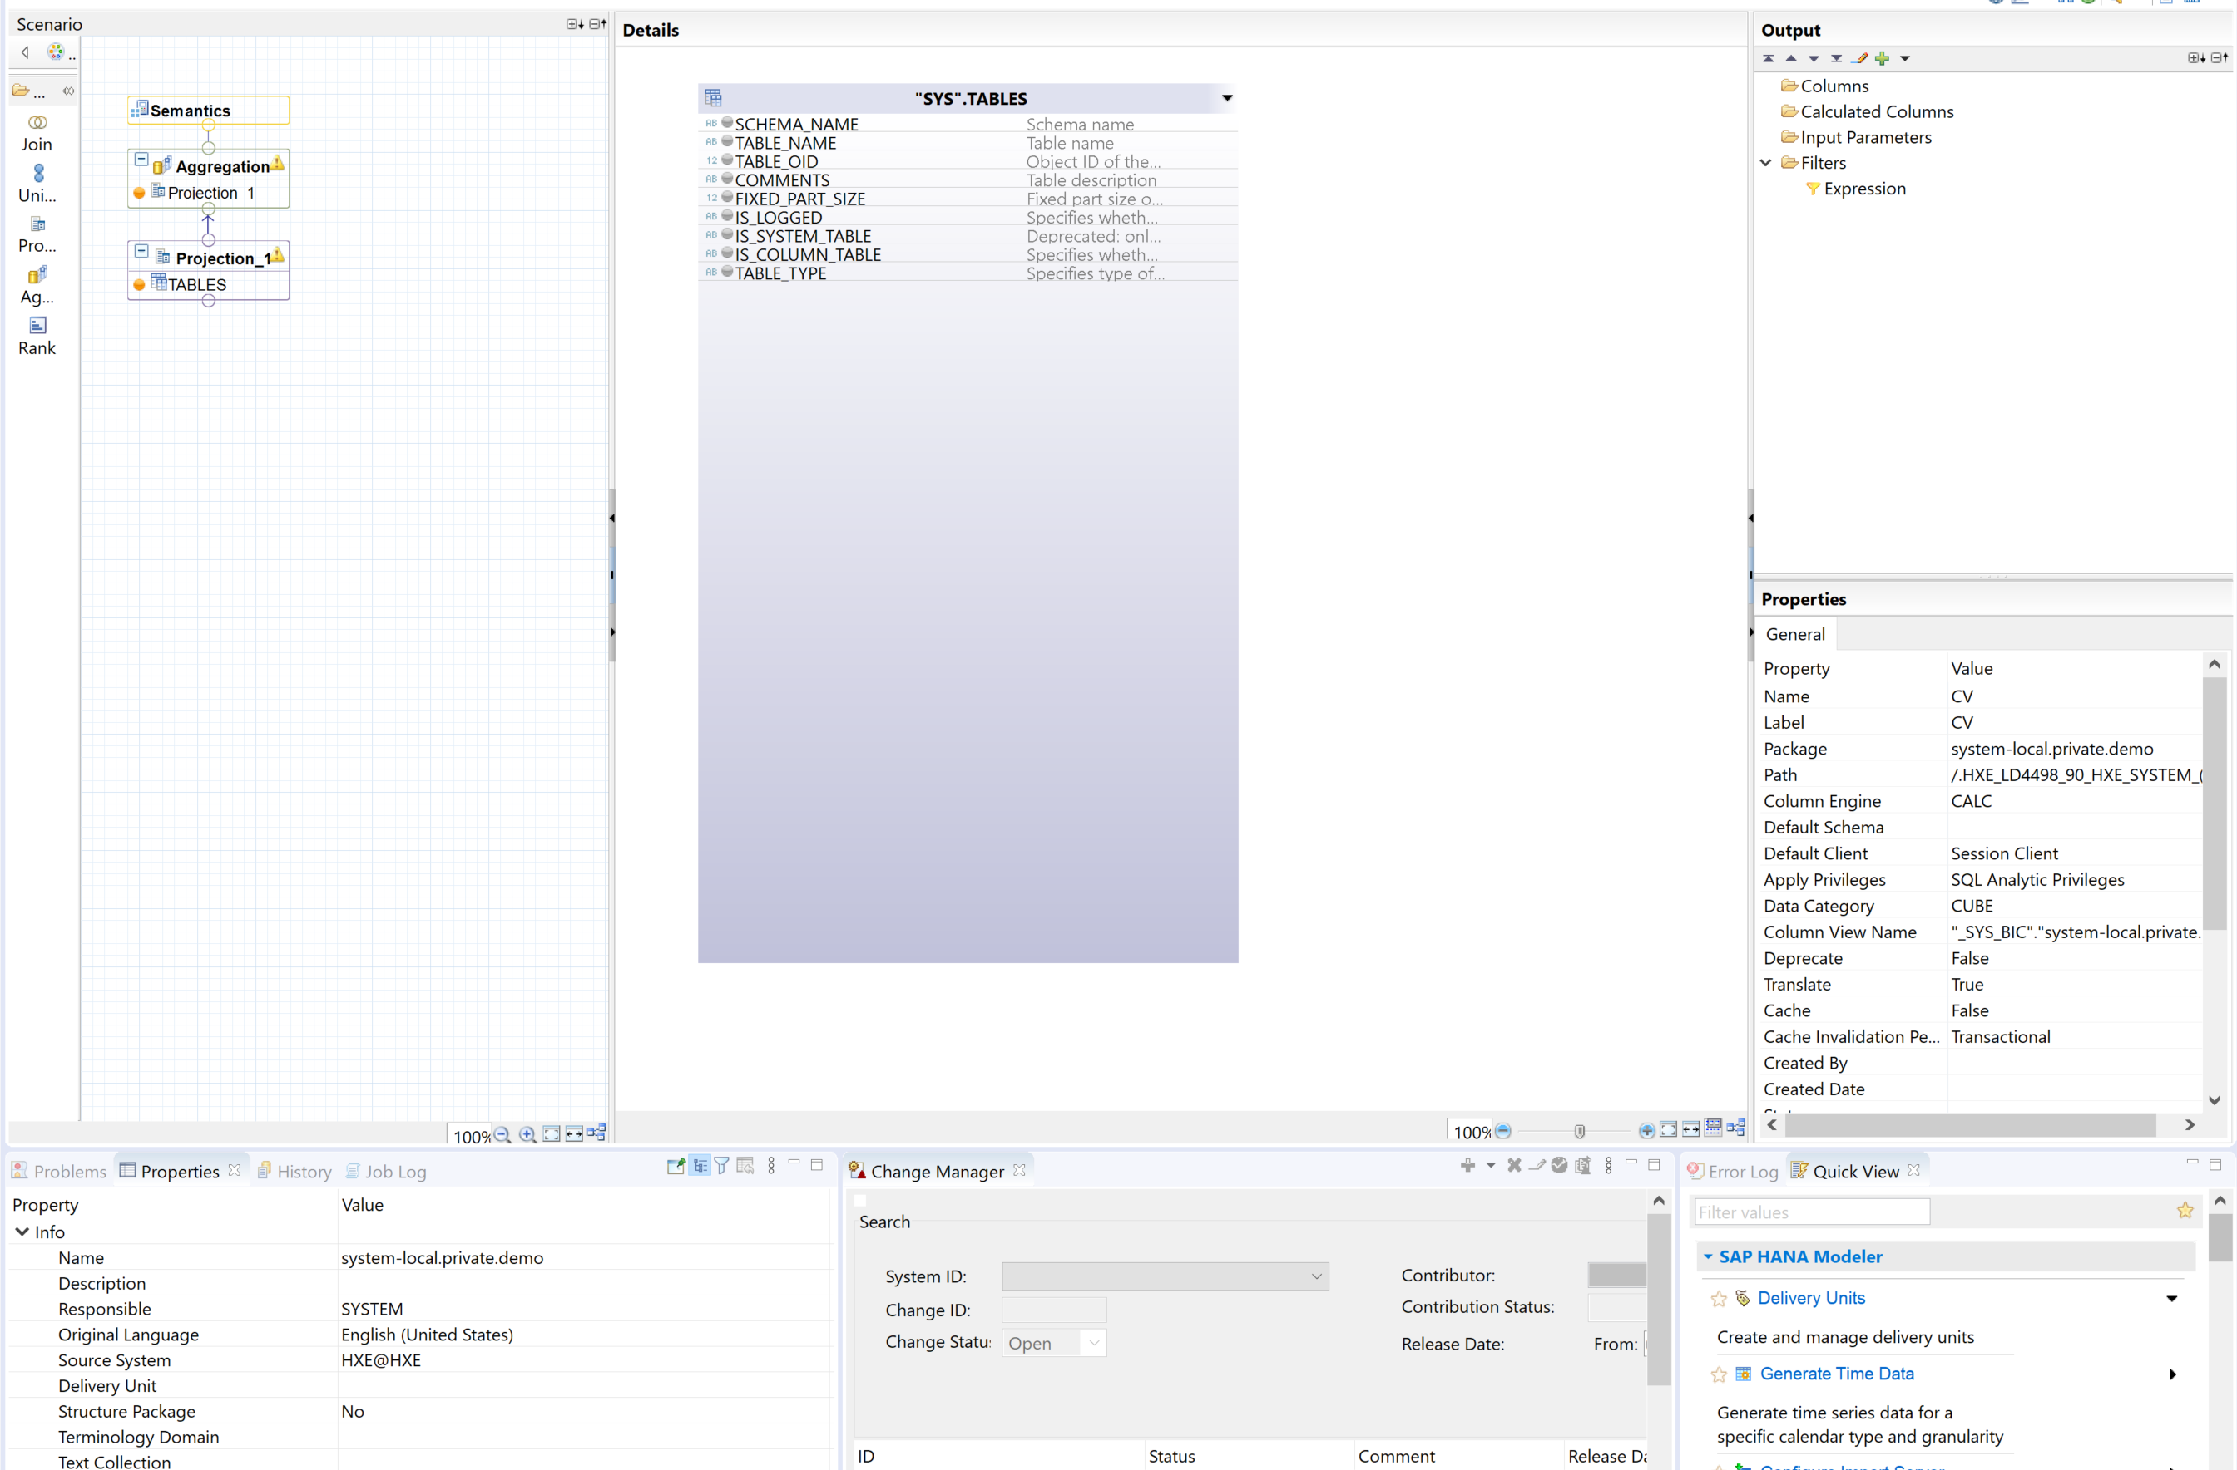
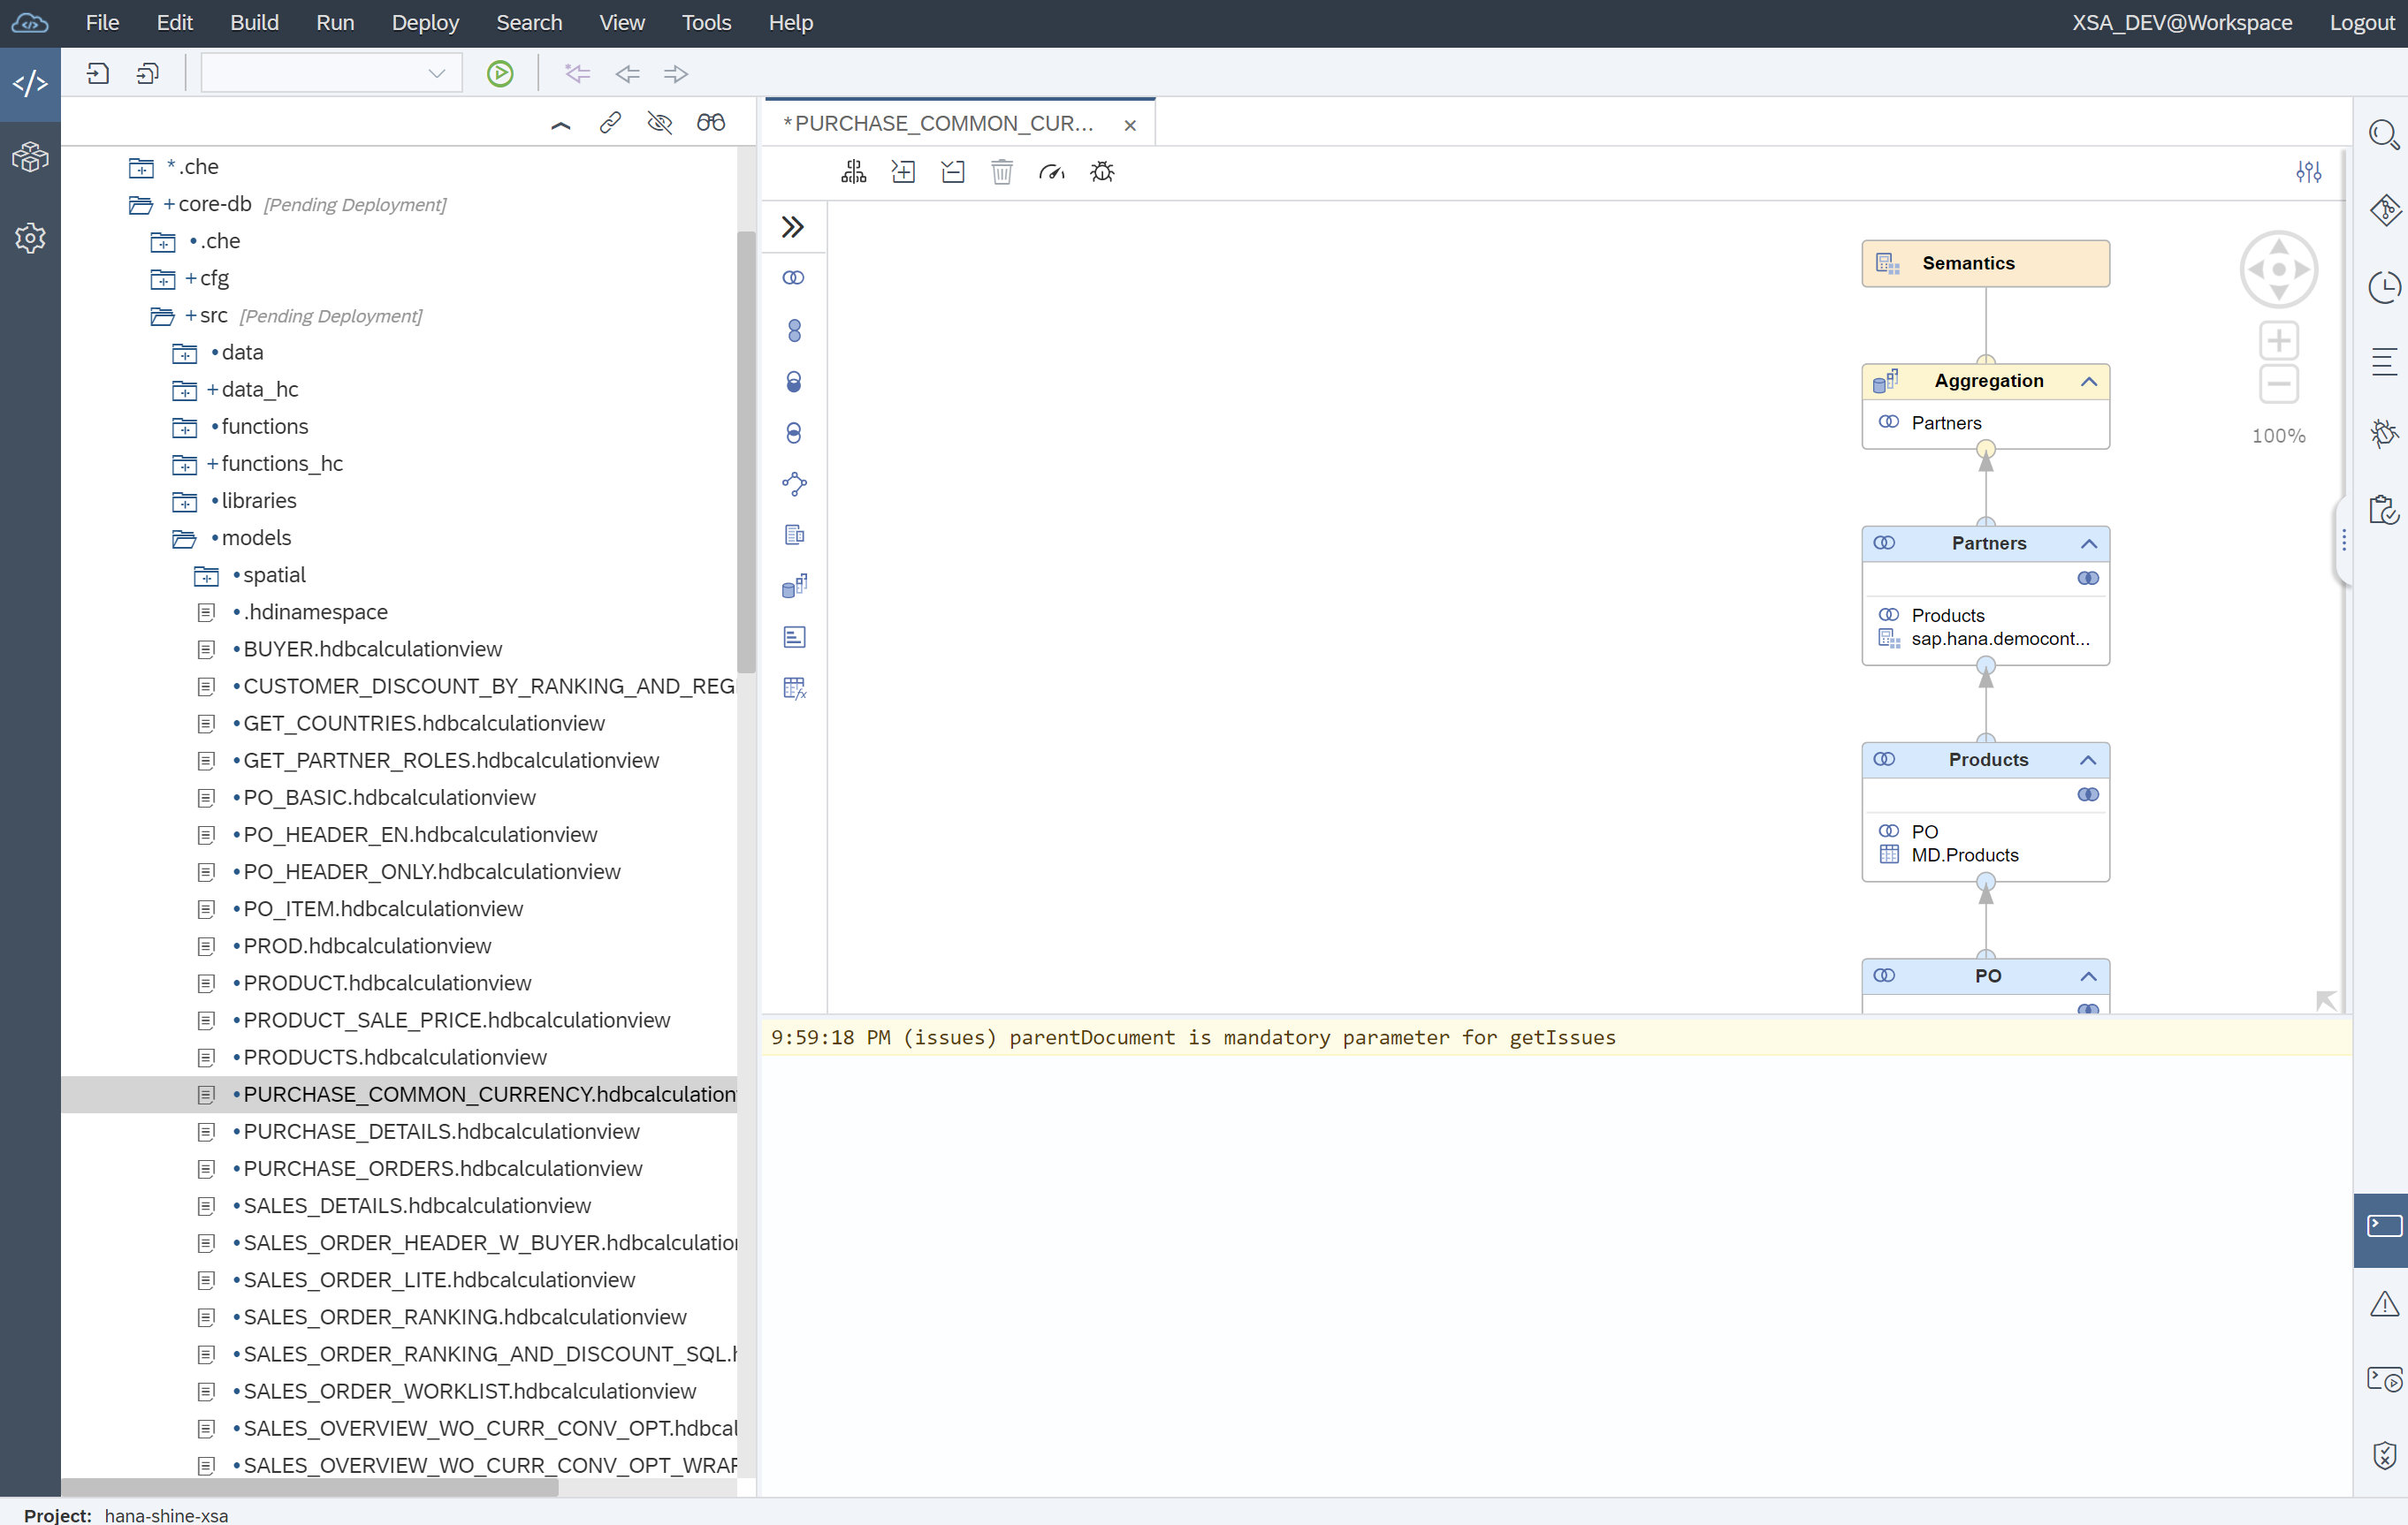
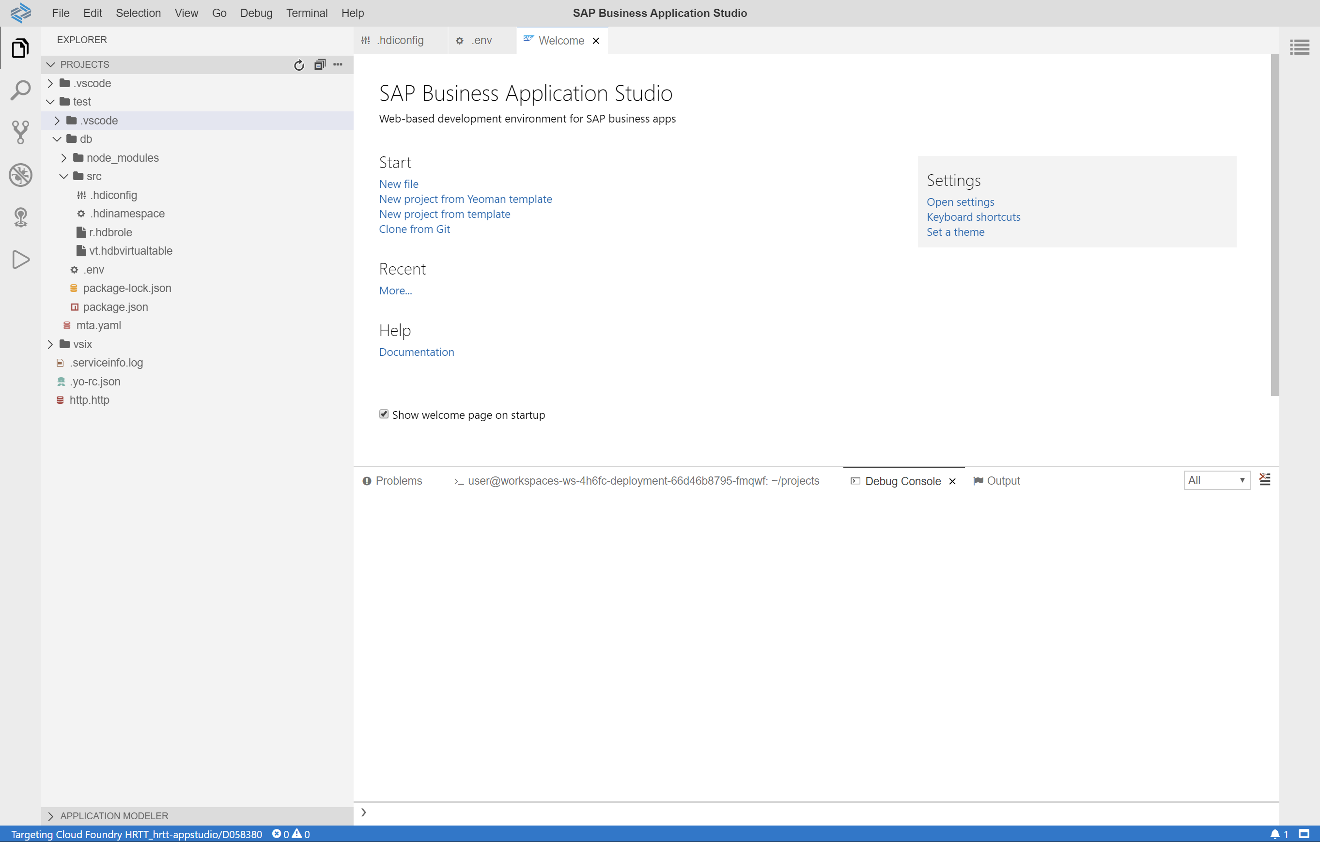

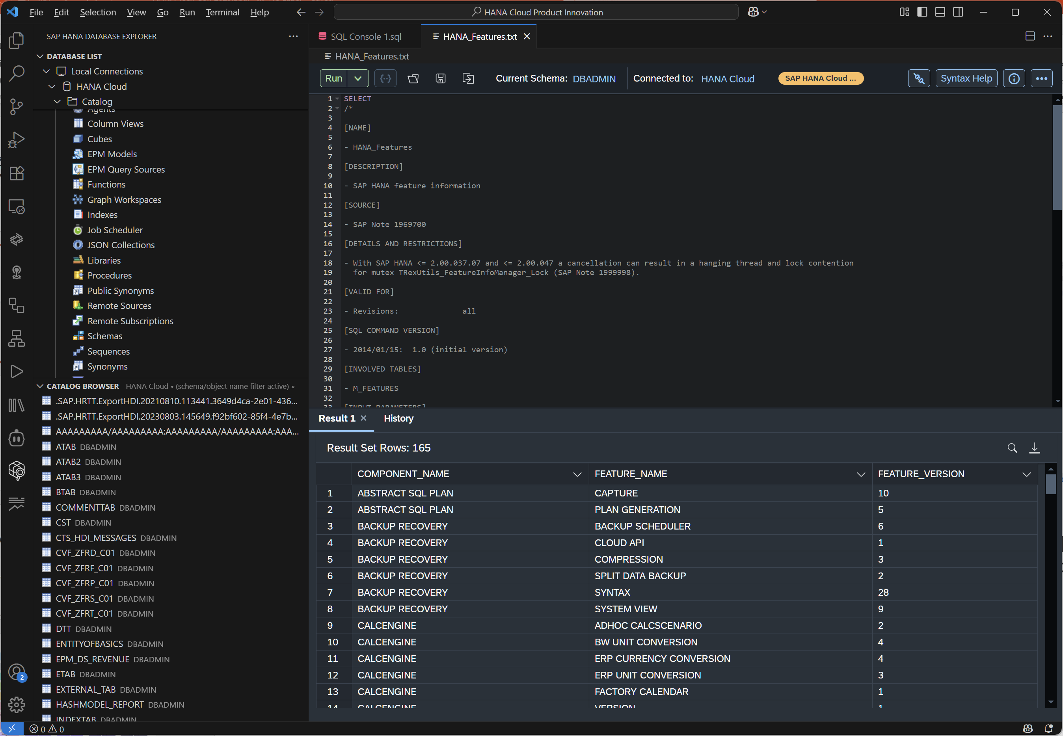
History of Native SAP HANA Development
SAP HANA Studio
SAP Web IDE
SAP Business Application Studio
Visual Studio Code

Slide 3



Visual Studio Code Extensions for SAP HANA Cloud

Slide 4

SAP HANA Database Explorer
Features
Database Connection Management
Local connections
SAP HANA Database Explorer connections
SAP HANA XS Advanced connections
SQL Console
Statement execution
Statement and query result formatting
Metadata Dialogs
Dependency Viewer

Slide 5
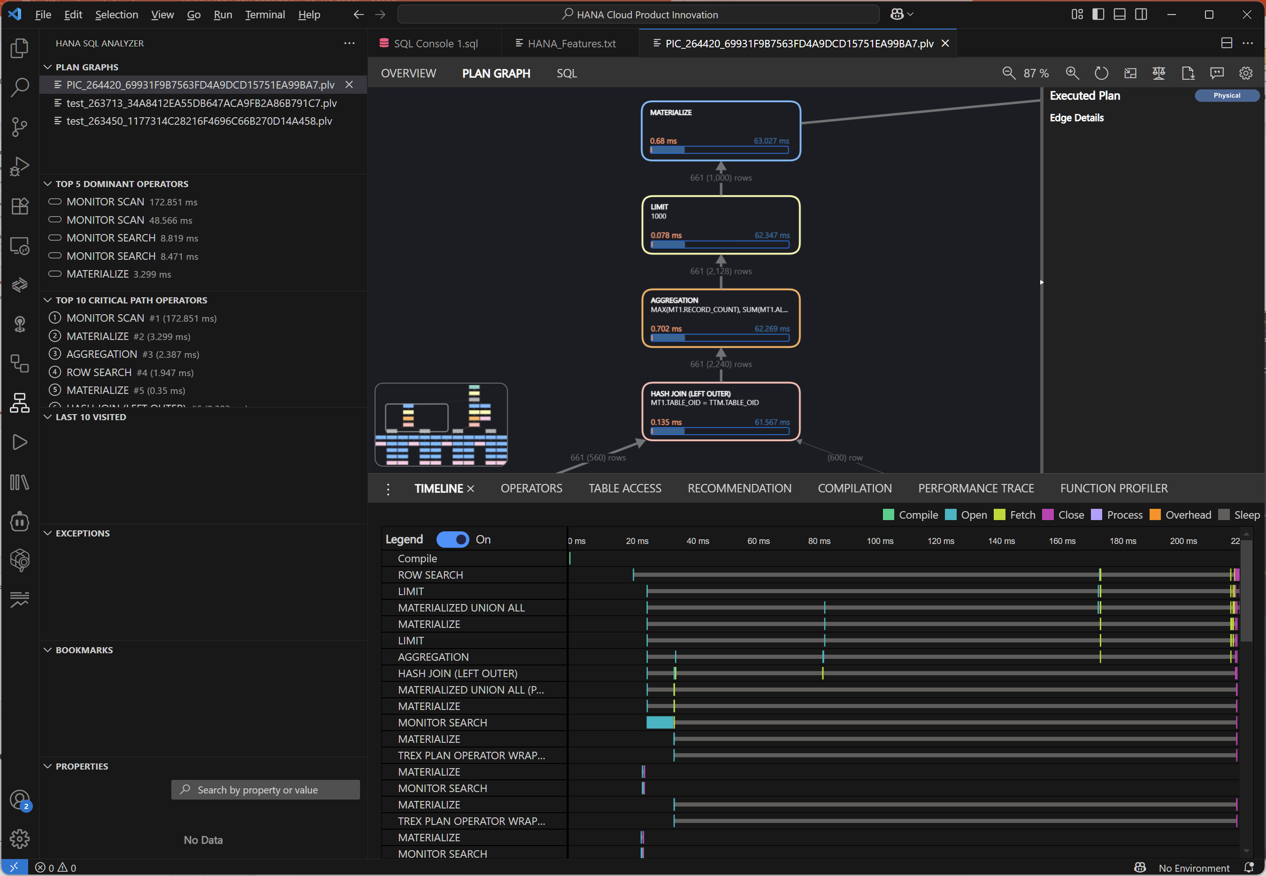
SQL Analyzer
Features
Get insights into important KPIs of the SQL query plan
Analyze visualized SQL query plan
Examine different characteristics and parameters of the SQL query plan
Monitor, visualize, and analyze running SQL queries
Compare two SQL query plans' KPIs
Collaborate with other developers and administrators to improve SQL query performance

Slide 6
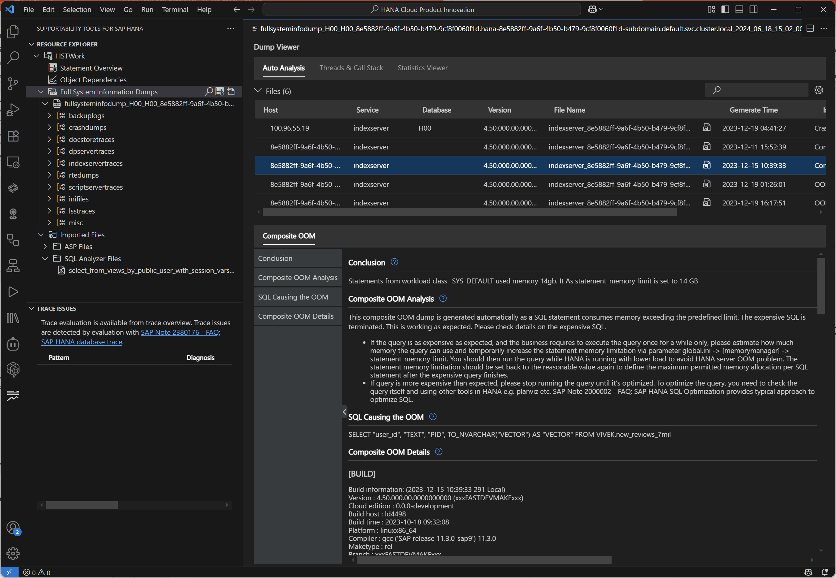
Supportability Tools
Offline Analysis
Trace Overview
Dump File Viewer
Auto Analysis
Threads and Call Stacks
Statistics Viewer
Name Server History Trace Viewer
Parameter Viewer
Abstract SQL Plan Viewer
Online Analysis
Statement Overview
Plan Trace
Object Dependency

Slide 7
Demo

Slide 8
References
VS Code Marketplace
SAP HANA Database Explorer
SQL analyzer tool for SAP HANA
supportability tools for SAP HANA
Supporting Extensions
Cloud Foundry Tools
SAP Business Application Studio toolkit
Documentation
SAP HANA Cloud Database Developer Guide
SAP HANA Cloud SQL Analyzer

Slide 9
Thank you.
Jonathan Bregler
jonathan.bregler@sap.com
Thomas Grimmeisen
thomas.grimmeisen@sap.com

Slide 10
Color palette
Blue 2 #D1EFFF
Blue 4 #89D1FF
Blue 6 #1B90FF
Blue 7 #0070F2
Blue 10 #002A86
Blue 11 #00144A
Grey 2 #EAECEE
Grey 4 #A9B4BE
Grey 6 #5B738B
Grey 7 #475E75
Grey 10 #1A2733
Grey 11 #12171C
Teal 2 #C2FCEE
Teal 4 #2CE0BF
Teal 6 #049F9A
Teal 7 #07838F
Teal 10 #02414C
Teal 11 #012931
Green 2 #EBF5CB
Green 4 #97DD40
Green 6 #36A41D
Green 7 #188918
Green 10 #164323
Green 11 #0E2B16
Mango 2 #FFF3B8
Mango 4 #FFC933
Mango 6 #E76500
Mango 7 #C35500
Mango 10 #6D1900
Mango 11 #450B00
Red 2 #FFD5EA
Red 4 #FF8CB2
Red 6 #EE3939
Red 7 #D20A0A
Red 10 #5A0404
Red 11 #350000
Raspberry 2 #FFDCE8
Raspberry 4 #FEADC8
Raspberry 6 #FA4F96
Raspberry 7 #DF1278
Raspberry 10 #71014B
Raspberry 11 #510136
Pink 2 #FFDCF3
Pink 4 #FF8AF0
Pink 6 #F31DED
Pink 7 #CC00DC
Pink 10 #510080
Pink 11 #28004A
Indigo 2 #E2D8FF
Indigo 4 #B894FF
Indigo 6 #7858FF
Indigo 7 #5D36FF
Indigo 10 #1C0C6E
Indigo 11 #0E0637

